Slide 1

E-Commerce Shipping Data

Slide 2
Introduction
This project describes some key insights for an international e-commerce company based on their customer database.
I did some preprocessing and EDA to understanding the dataset.
I used machine learning models (logistic regression model and kneighbor classifier) to predict the target(reached on time N.Y.).

Slide 3
Datasets Description:
The dataset used for model building contained 10999 observations of 12 variables. The data contains the following information:
ID: ID Number of Customers.
Warehouse block: The Company have big Warehouse which is divided in to block such as A,B,C,D,E.
Mode of shipment: The Company Ships the products in multiple way such as Ship, Flight and Road.
Customer care calls: The number of calls made from enquiry for enquiry of the shipment.
Customer rating: The company has rated from every customer. 1 is the lowest (Worst), 5 is the highest (Best).
Cost of the product: Cost of the Product in US Dollars.
Prior purchases: The Number of Prior Purchase.
Product importance: The company has categorized the product in the various parameter such as low, medium, high.
Gender: Male and Female.
Discount offered: Discount offered on that specific product.
Weight in gms: It is the weight in grams.
Reached on time: It is the target variable, where 1 Indicates that the product has NOT reached on time and 0 indicates it has reached on time.

Slide 4
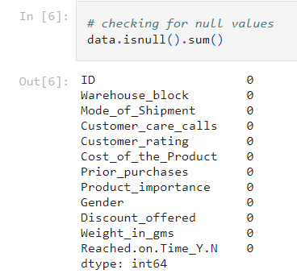
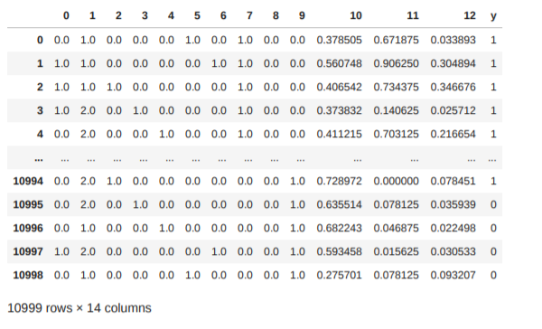
Data Preprocessing
Checking for missing values and dropping them
Transform the data

Slide 5
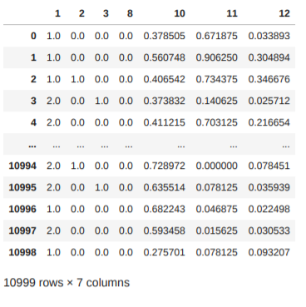
Data Preprocessing
Independent features(columns) that affect on the target

Slide 6
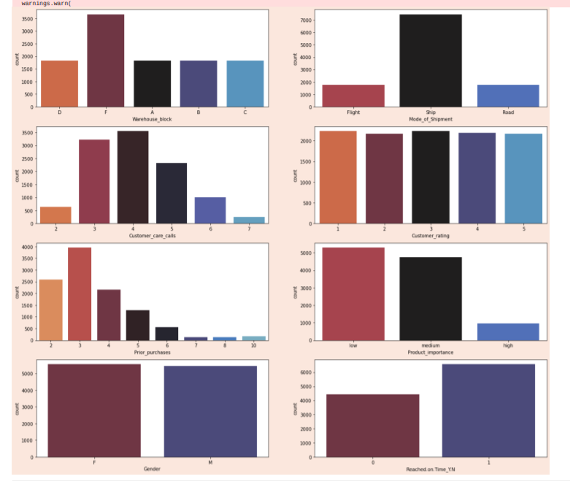
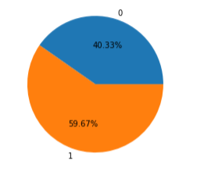
Data Analysis and Visualization
Visualizing the important features(columns)
Visualizing the target (reached on time N.Y.).

Slide 7
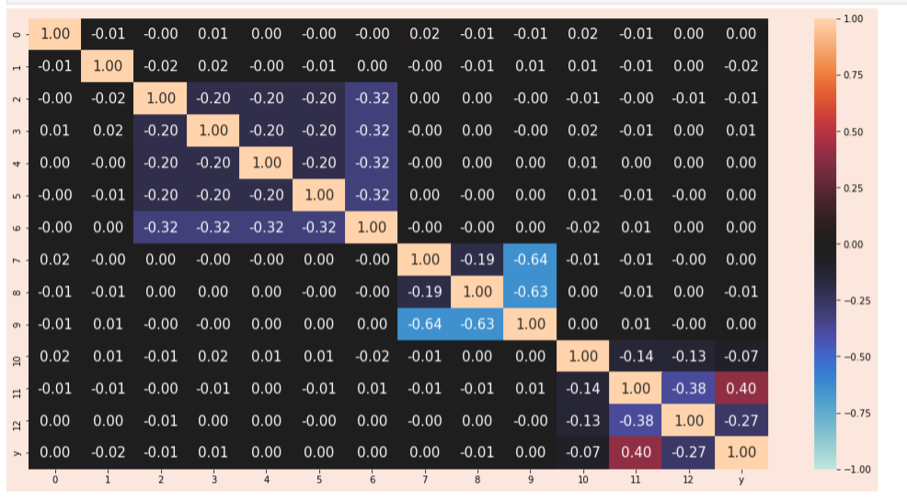
Data Analysis and Visualization
Plotting correlation matrix between features(transformed)

Slide 8
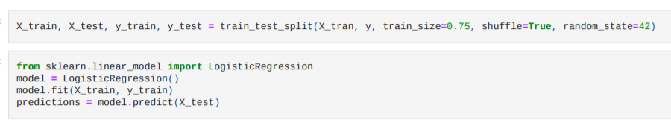
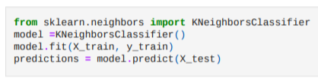
Machine learning Model
Splitting data for training and testing
Building machine learning model (logistic regression and kneighbor classifier )

Slide 9



Cross Validation
logistic regression
kneighbor classifier

Slide 10
Thanks

